Slide 1

Information Security Officer's
Advisory Group
WELCOME TO THE Oct. 1, 2025 ​
ISOAG MEETING​
Notes:
Title slide - Any text that looks black is HEX code 414042. If you have an idea for an image, let me know and I can provide you with one.

Slide 2
IT Security Governance & Compliance
2025 Highlights and 2026 Plans
Amy Braden
Director of IT Security Governance and Compliance
October 1st, 2025

Slide 3

Agenda
  Organization Overview
  2025 Highlights
  2026 Plans
vita.virginia.gov

Slide 4
2025 Highlights
  Released SEC540 Data Classification and updated SEC502 IT Security Audit Standard, SEC527 Cybersecurity Awareness Training Standard, and SEC528 Prohibited Hardware, Software and Services Policy
  Supported SSA and FTI audits
  Integrated ISO Services into service delivery (SSPs)
  Increased ISO outreach programs
vita.virginia.gov

Slide 5
2026 Plans
  Provide additional guidance and clarity for key topics
  Provide customizable ISO Services engagements
  Support SSA and FTI audits
  Mature ISO outreach programs
  Update CY2025 Data points/Agency Metrics
    New: Self Assessment (Pass/Fail) – NCSR assuming available
    Remove: IDS Reporting
  Enforce SAT campaign requirements (e.g., naming conventions)
vita.virginia.gov

Slide 6
CISS Service Delivery
Who are we?
CISS is one of 2 security consulting services provided through VITA CSRM to assist agencies with Governance, Risk and Compliance requirements prescribed by our Commonwealth Standards.
What we do?
CISS seeks improve client organizations security cultures by providing GRC consulting services leading organizations to successful completion of security compliance activities.
Tri-annual BIA
Annual BP reviews
IT System and Data Classification
System Security Plans
Risk Assessments

Slide 7
CISS Service Delivery
Who do we serve?
CISS is the go-to GRC-as-a-Service provider servicing COV executive branch agencies, institutions of higher learning, VITA suppliers, and expanding to partner with localities and commissions.
Current client portfolio
24 client organizations
VITA supplier support
Q4-2024 to Q3 2025 Accomplishments
CISS provides GRC consulting services leading organizations to successful completion of security compliance activities.
58% BIA/BP reviews for 100% compliance
15 organizational SSP’s
56 system specific SSP’s
47 risk Assessments
Intake for 50+ VITA supplier services

Slide 8



CISS Future State
Where are we going? Q4 2025 and beyond
Future client portfolio
5 potential new clients Q4 2025
New FY-27 MOU addendums for existing clients
Project Management
Project Charter/Plans
AgilePlace/KSE
ISO Service Office Hours
CISS Staffing
3 Approved positions
2 Leads
Designated VITA/VITA supplier support team
Leverage PM support

Slide 9

How to contact us
Amy Braden
Director, IT Security Governance & Compliance
amy.braden@vita.virginia.gov
Michael Vannoy
Manager, Centralized ISO Security Services
michael.vannoy@vita.virginia.gov

Slide 10
Thank you!
Questions?

Slide 11
VITA Enterprise & Security Architecture
2025 Accomplishments and 2026 Plans
Chris Williams
Director of Enterprise & Security Architecture
October 1st, 2025

Slide 12
Agenda
EA and SA – Our Objectives
Who we are
What we do
What we did in 2025
Our plans for 2026

Slide 13
Security and Enterprise Architecture – Our Objectives
Strategic Alignment and Business Value
· Align technology strategy and architecture with the Commonwealth’s business goals and citizen service outcomes.
· Measure and communicate the value of IT investments in terms of efficiency, cost savings, and improved services.
Technology Standards and Interoperability
· Define and maintain technology standards, reference architectures, and integration patterns.
· Ensure interoperability across agencies by promoting shared platforms, APIs, and data exchange frameworks.
Enterprise Portfolio Management
· Maintain visibility into enterprise systems, data assets, and business processes.
· Optimize IT investments by reducing duplication and promoting reuse.
· Provide decision-makers with insights to guide system retirements, consolidations, and modernization.
Governance and Compliance (Architecture)
· Establish EA governance processes to ensure alignment with statewide standards.
· Balance centralized oversight with agency-level flexibility in the federated model.
· Ensure architectural compliance in project reviews and procurement processes.

Slide 14
Security and Enterprise Architecture – Our Objectives (cont’d)
Innovation and Future-State Planning
· Continuously scan for emerging technologies and assess their applicability for government services.
· Develop technology roadmaps that support digital transformation and long-term resilience.
· Pilot and scale secure, innovative solutions across agencies.
Information and Data Management
· Promote enterprise-wide data management, classification, and sharing practices.
· Enable secure, standardized data exchanges to improve decision-making and service delivery.
· Support data governance frameworks that align with security and privacy requirements.
Asset and Lifecycle Management
· Establish enterprise approaches for technology lifecycle management (from acquisition through retirement).
· Drive sustainable, cost-effective IT practices across the enterprise.
Stakeholder Collaboration and Guidance
· Act as a trusted advisor to agencies by providing reference architectures, templates, and playbooks.
· Coordinate with agency CIOs and IT leaders to harmonize enterprise standards with local needs.
· Promote shared services and cross-agency initiatives to improve efficiency.
Workforce and Skills Development
· Provide training and guidance to IT and business leaders on enterprise architecture principles.
· Build capacity for architectural thinking and system-level design across agencies.

Slide 15
Enterprise Architecture - What We Do
15
Service Towers
End User Compute
Mainframe
Managed Cloud
Messaging
MSI
MSS
SSDC
VITA
Voice/Network
Enterprise Architecture
AI Registry
Arch Review
ARCPs
Ardoq Content
DNS
Exceptions
IBCs
ITSPs
PGRs
RFPs
RTMs
Roadmaps
SOWs
Standards
Agencies
Executive Branch
Higher Ed
Localities
Out of Scope
Roadmaps
Standards
Roadmaps
Standards
Arch Review
Ardoq Content
Exceptions
ARCPs
RTMs
Procurement
AI Registry
Arch Review
Ardoq Content
DNS
Exceptions
IBCs
ITSPs
PGRs
RFPs
SOWs

Slide 16
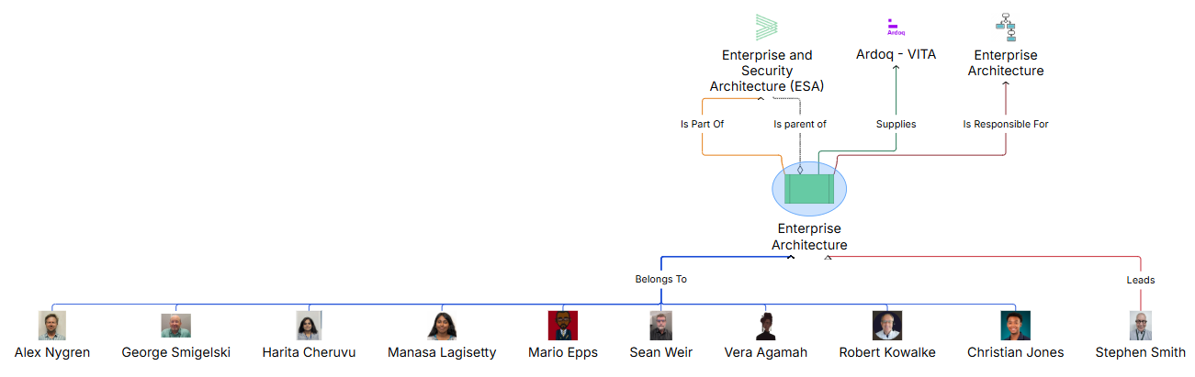
Enterprise Architecture– Who We Are

Slide 17
Enterprise Architecture – 2025 Accomplishments
Containerization Standard
  Created and put through ORCA and Platform for review
    Standard created in partnership with agencies, VITA, and its suppliers
  Working on Final Approvals, to be published “soon”
Ardoq, change in scope & rollout
  Agency and VITA usage of tool
  Supplier tools
Technology roadmaps
  Updated model for roadmaps, utilizing Ardoq

Slide 18
Enterprise Architecture – 2025 Accomplishments (cont’d)
AI Registry & COP
Led AI Community of Practice, held multiple AI COP meetings
Updated AI Roadmap
Business & Technical Capability mapping
  Applied to Enterprise application portfolio
App modernization
  Enhanced agency data capture
  Took Ownership of Application Lifecycle Management
Updated EA portion of VITA website
Notes:
For the chart, is it showing us what our tickets look like, or is it showing overall what categories our work falls into?

Slide 19
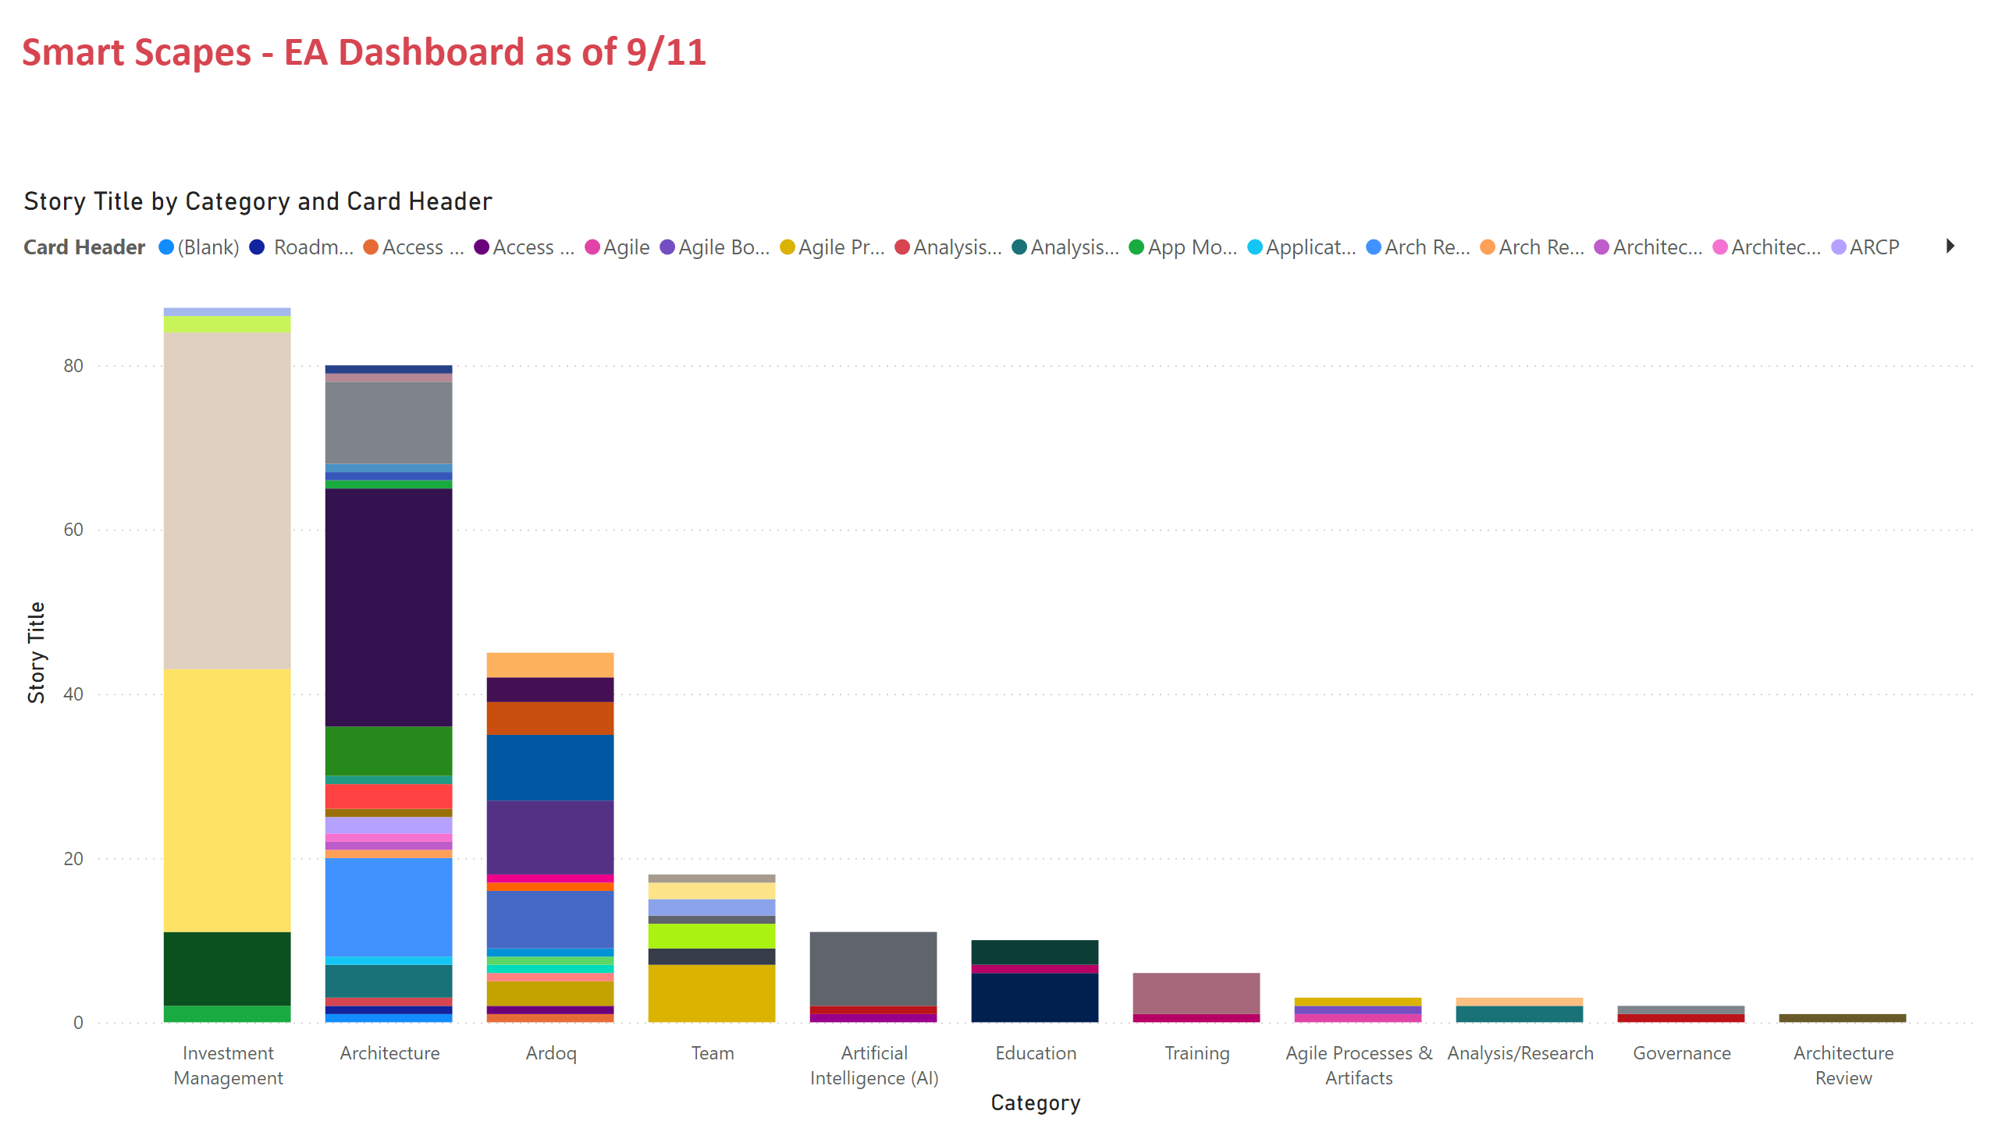
Enterprise Architecture – Types of Work for last 3 Sprints

Slide 20
Enterprise Architecture – 2026 Priorities
Proactive
Ardoq – platform, building out content, providing additional visibility into portfolio’s, providing greater insight into application portfolio
Growth with agencies, growth internally, adding functionality
Supplier tech portfolio
Patterns (AI, Cloud and other)
Standards
  Digitizing of standards – updating process/management, draw relationships between standards and patterns and other application data.
  Continuing to refine standards landscape
Additional application related data
  Contracts

Slide 21
Enterprise Architecture – 2026 Priorities (cont’d)
AI
Ai registry refinement
AI roadmap updates
AI COP
AI Standard updates
  Agentic AI
Roadmaps
  - Cloud services
AOD changes
  - “Breadbasket”
COV Ramp
Business and tech capability mapping
Fronting the onboarding process
Application Lifecycle Management (formerly App Modernization)
Driving this process
Helping agencies gain better insight into application portfolio

Slide 22
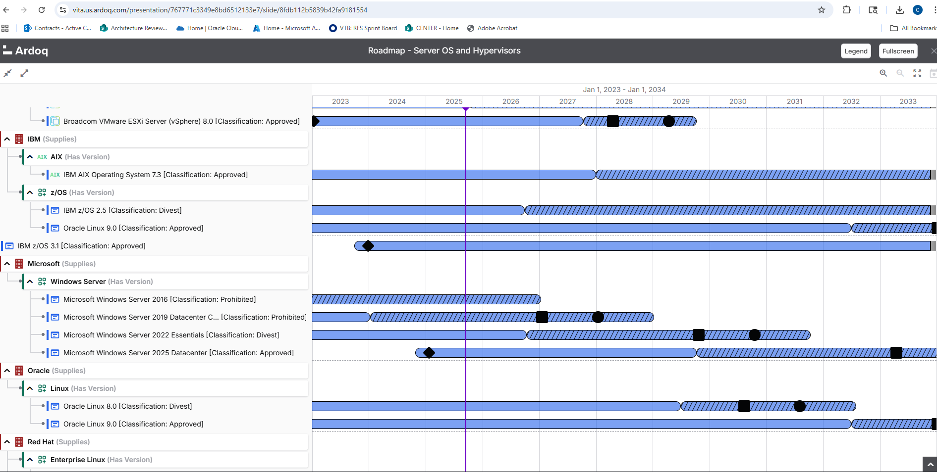
Enterprise Architecture – Ardoq – roadmaps example

Slide 23
Security Architecture – Who We Are
Chandos Carrow
Jacquelyn Esters
Jr. Security Architect
SSP Contractor Team
Preston Talbott

Slide 24
Security Architecture– 2025 Accomplishments
Over 100 security baselines reviewed
Over 40 RITMs/INC tickets assessed
Over 150 security exceptions assessed
Over 350 RFS DMND requests reviewed
Over 30 SSPs Evaluated
Over 20 special projects completed, several more still in progress
Involvement in 7 RFPs

Slide 25
Security Architecture – 2026 Priorities
Proactive / Communications / Documentation
Reoccurring Information Security Requirements for SEC530
  A document that identifies all of the events in SEC530 that a reoccurring frequency
Roles and Responsibilities Matrix for SEC530
  A document that identifies all of the events in SEC530 that a reoccurring frequency
Updates to SSP templates
Port Baseline
  Identification of the accepted and unaccepted communications ports between the zones of the Zero Trust model

Slide 26
Security Architecture – 2026 Priorities (cont’d)
Well Architected Cloud Framework
  A framework for all cloud service providers that identifies the network requirements to operate
Entra ID Process documentation
  Framework establishing how the various software as a services throughout the Commonwealth shall connect for identification and authorization purposes to the COV Entra ID
Control Assessment forms
  Forms to assist those with being compliant to CA-2
Baseline Instructions
  Instructions for both suppliers and the Baseline Steering Committee on how the baseline process operates and what goes into a baseline
Enterprise SSP Evaluation Instructions
  Instructions for both suppliers and the Evaluation team on how the SSP Evaluation process operates and what goes into the creation of a SSP

Slide 27
Questions?

Slide 28
Centralized IT Security Audit Service
Mark McCreary, CISA®, CISSP®, CISM®
Director
Razaq Aweniya, CISA®
Senior IT Auditor
Notes:
No image title slide - Any text that looks black is HEX code 414042.

Slide 29

Top Ten Countdown
vita.virginia.gov
Notes:
This slide background works best with text heavy sections, with no imagery OR when an Icon is used

Slide 30

Top Ten Audit Issues
Not documenting how the impacts resulting from a compromise of data confidentiality, integrity, or availability were determined.
vita.virginia.gov
Notes:
This slide background works best with text heavy sections, with no imagery OR when an Icon is used

Slide 31

Top Ten Audit Issues 9
Top Ten Audit Issues
Limited review and analysis of audit logs.
vita.virginia.gov
Notes:
This slide background works best with text heavy sections, with no imagery OR when an Icon is used

Slide 32

Top Ten Audit Issues 8
Top Ten Audit Issues
  Not Disabling Inactive Application Accounts
vita.virginia.gov
Notes:
This slide background works best with text heavy sections, with no imagery OR when an Icon is used

Slide 33

Top Ten Audit Issues 7
Top Ten Audit Issues
Agency Head not formally designating System Owners, System Owners not designating Data Owners and/or System Admins.
vita.virginia.gov
Notes:
This slide background works best with text heavy sections, with no imagery OR when an Icon is used

Slide 34

Top Ten Audit Issues 6
Top Ten Audit Issues
  Not using Two-Factor Authentication
  When accessing sensitive systems over the Internet
  When using a network connection to access development environments or perform administrative functions on servers or multi-user systems
vita.virginia.gov
Notes:
This slide background works best with text heavy sections, with no imagery OR when an Icon is used

Slide 35

Top Ten Audit Issues
5
Top Ten Audit Issues
  Privilege escalation using regular network accounts, for example, adding a regular network user account to a computer’s Local Administrator Group or other groups used to control access to security functions.
vita.virginia.gov
Notes:
This slide background works best with text heavy sections, with no imagery OR when an Icon is used

Slide 36

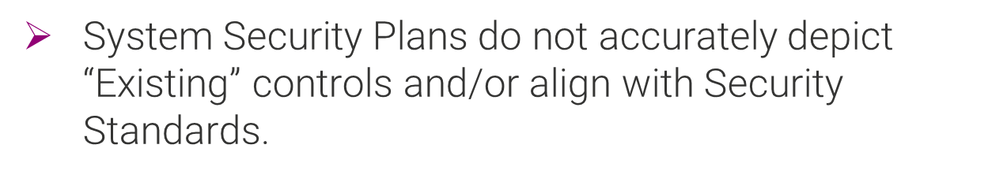
Top Ten Audit Issues
4
Top Ten Audit Issues
vita.virginia.gov
Notes:
This slide background works best with text heavy sections, with no imagery OR when an Icon is used

Slide 37

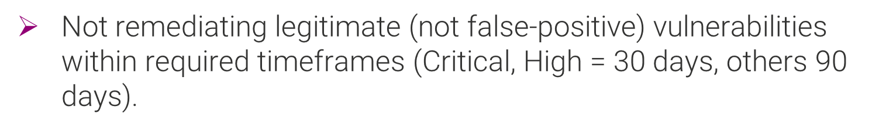
Top Ten Audit Issues
3
Top Ten Audit Issues
vita.virginia.gov
Notes:
This slide background works best with text heavy sections, with no imagery OR when an Icon is used

Slide 38

Top Ten Audit Issues
2
Top Ten Audit Issues
The ISO does not report directly to the Agency Head and/or is responsible for IT.
vita.virginia.gov
Notes:
This slide background works best with text heavy sections, with no imagery OR when an Icon is used

Slide 39
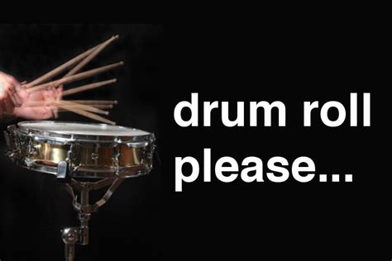
Drum Roll to for Final top Audit Issue
Top Ten Audit Issues
vita.virginia.gov
Notes:
This slide background works best with text heavy sections, with no imagery OR when an Icon is used

Slide 40

Top Ten Audit Issues
1
Top Ten Audit Issues
Approved Security Exceptions are not on file for known control failures.
vita.virginia.gov
Notes:
This slide background works best with text heavy sections, with no imagery OR when an Icon is used

Slide 41

Top Ten Audit Issues
Bonus
Top Ten Audit Issues
No Formally Documented and Approved IT Security Policies and Procedures or Alignment with Security Standards is lacking.
vita.virginia.gov
Notes:
This slide background works best with text heavy sections, with no imagery OR when an Icon is used

Slide 42
What Can You Do?
Contact CSRM!
Become familiar with Security Standards. If you have a question about a control, the Governance team can provide clarification or an interpretation.
Architects can help with security exceptions and identifying mitigating controls.
Work with Governance to close findings when corrective actions are complete.
Provide quarterly finding updates to CSRM to maximize that component of the annual audit score.
vita.virginia.gov
Notes:
This slide background works best with text heavy sections, with no imagery OR when an Icon is used

Slide 43
Questions
Mark McCreary
Mark.McCreary@vita.virginia.gov
Razaq Aweniya
Razaq.Aweniya@vita.virginia.gov
Notes:
This slide is used as a transition title slide for a new section

Slide 44
Risk Management Update
VITA Risk Management
Jonathan Smith

Slide 45
Agenda
  Cyber Liability Insurance Update
  Risk Register – Purpose and Process Updates
  Team Contacts
vita.virginia.gov

Slide 46
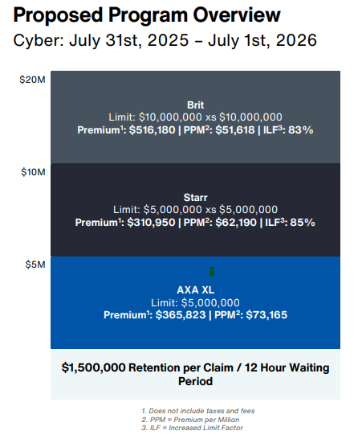
Cyber Liability Insurance
Renewal of the Executive Branch cyber insurance policy
  Total Limit: $20,000,000 Retention:$1,500,000
  Total Premium: $1,192,953
  Premium Savings: $376,000 reduction in annual premium costs
  Coverage Enhancements: Improved primary language and expanded coverage terms
vita.virginia.gov

Slide 47
Risk Register
Goal and Purpose
  Establish a standardized approach to agency-level risk assessments, enhance enterprise-wide reporting, and shift focus beyond compliance
  Direct agencies to conduct risk assessments based on the risks specified in the risk register
  This standardization will help agencies focus on risks CSRM has identified as important and enable CSRM and agencies to summarize system level risk to facilitate agency, secretariat, and enterprise level reporting
vita.virginia.gov

Slide 48
Risk Register
Process
  The agency risk assessment process will largely remain the same: agencies must submit Risk Assessment Plans (RAPs), conduct Risk Assessments(RAs) every three years, and report Risk Findings via Risk Treatment Plans (RTPs) to CSRM.
  The primary change is in the output: RTPs should directly reflect the assessments related to the risk register, with risk finding statements clearly mapping back to the register (e.g., “Risk of unauthorized access”)
The Risk Management Team will perform several workshops at the Risk Management Committee Meetings, and we are willing to work with agencies 1 on 1 as we get closer to the register being a requirement.
vita.virginia.gov

Slide 49
Risk Register
Process Continued- Risk Findings
  Risk Findings will tie directly to the risk register item(s) they associate to.
  Risk findings will function the same way, quarterly updates required, showing mitigation to reduce the risk to an acceptable level.
  If specific control gaps are identified as elevating risk, those controls will be documented in the risk finding mitigation plan. If the control gaps are not expected to be remediated within 90 days an exception will be required.
vita.virginia.gov

Slide 50
Access and Authorization Risks
Risk | Risk Description | Threat Agent | Vulnerability | Impact | Mitigation
Repudiation | The inability to maintain accountability (eg, asset ownership, non-repudiation of actions or inactions | Insider threats, cyber criminals, malware, software vulnerabilities | Weak Digital signatures, insufficient logging, poor time stamping, weak authentication, data integrity issues | Fraud, data manipulation; Legal disputes, operational confusion, financial loss | Digital signatures, authentication, auditing, logging services, tamper proof records
Improper Assignment of Privileged Functions | Inability to implement least privileges (eg, Role Based Access, Privileged Account Management) | Insider threats, cyber criminals, malware, software vulnerabilities, negligent administrator | Unnecessary elevated privileges, default privileged accounts, insufficient role-based access controls (RBAC), Lack of privilege reviews, insecure configurations | Fraud, data manipulation, data breach, unauthorized actions, regulatory violations, reputational damage | Least privilege, account monitoring, RBAC, automated provisioning, regular audits, approval processes, Training
Privilege Escalation | The inability to restrict access to privileged functions | Insider threats, cyber criminals, malware, social engineering, stolen credentials, misconfigurations | System misconfiguration, software vulnerabilities, weak passwords, improper access controls, kernel exploits, unsecured services, outdated software | Data breach, system disruption, lateral movement | Least privilege, Multi-Factor Authentication, Patching, Account Monitoring, Vulnerability Scanning
Unauthorized Access | The inability to restrict access to only authorized individuals, groups or services, account termination | Insider Threats, Cyber criminals, organized crime groups, nation-state actors, Third Party Contractors, | Weak passwords, lack of MFA, phishing attacks, unpatched software, misconfigurations, injection flaws, inadequate access controls, insider threat, unrevoked access, shared accounts, | Fraud; data manipulation; data exposure, budget drain, legal fallout, reputational damage | Digital signatures, authentication, auditing, logging services, access revocation, vendor vetting, endpoint security
vita.virginia.gov

Slide 51
Operational Risks
Risk | Risk Description | Threat Agent | Vulnerability | Impact | Mitigation
Mission Interruption | Interruption of COV mission critical business processes due to MEF and PBF not properly supported | Cyber attacks, natural disasters, infrastructure failures, human error, supply chain disruption, insider threats, insufficient capacity | Lack of redundancy, insufficient disaster recovery planning, poor change management, inadequate security controls, untested backups, supply chain weaknesses | Potential loss of life, negative impact to safety, disruption of critical services to citizens, reputational damage | Access Controls; IDS/IPS; Employee Training; Data Backup & Recovery; Cyber Insurance; Business Interruption Insurance; Continuous Monitoring
Business Interruption | Increased latency, or a service outage, that negatively impact business operations. | Cyber attacks, natural disasters, infrastructure failures, human error, supply chain disruption, insider threats, insufficient capacity | Lack of redundancy, insufficient disaster recovery planning, poor change management, inadequate security controls, untested backups, supply chain weaknesses | Loss of Revenue; Reputational Damage; | Access Controls; Firewalls; IDS/IPS; Employee Training; Data Backup & Recovery; Cyber Insurance; Business Interruption Insurance; Continuous Monitoring
Reduction in productivity | Diminished user productivity. | Underperforming vendor, cybercriminal, negligent contractor, Unreliable Supplier, Internal Misalignment | Third Party Downtime, Poor Integration, Inadequate Support, Over-Reliance, Lack of Training | Delayed Services, Backlogs, Staff Frustration, Financial Waste, Public Dissatisfaction | Vendor Performance Standards, Redundant Systems, Integration Testing, Responsive Support, Staff Training, Proactive Monitoring, Contingency Resources
Loss of revenue | A negative impact on the ability to generate revenue (e.g., a loss of clients or an inability to generate future revenue). | Third party vendor, cybercriminal, negligent contractor | Dependency on third parties, unsecured systems, lack of redundancy, poor contract terms, inadequate incident response | Lost Sales, customer churn, penalties and fines, reputational damage, recovery expenses | Vendor diversification, robust SLAs, Business Continuity Planning, Cybersecurity Investment, Rapid Response Protocols, Insurance, Customer Communication
Fines and judgements | Financial damages due to fines and/or judgements from statutory / regulatory / contractual non-compliance. | Third party service provider, cyber criminal, disgruntled contractor, federal/state regulator, public litigants | Lax vendor management, regulatory misalignment, unclear accountability, physical security gaps, delayed reporting | Direct Fines, court judgements, resource diversion, political fallout, service delays | Third party compliance framework, contractual safeguards, proactive audits, access restrictions, incident transparency, legal preparedness, public accountability
Reputational damage | Diminished brand value (e.g., tarnished reputation). | Incompetent vendor, cyber criminal, negligent contractor, media/activists, Disgruntled Citizens | Lack of oversight, Third-Party Misconduct, Poor Communication, Over-Dependence (third party), data exposure | Public distrust, political fallout, media scrutiny, reduced cooperation, service avoidance | Vendor vetting, Proactive Oversight, Crisis Communication, Accountability Clauses, Diversified Reliance, Public Engagement, Rapid Response
vita.virginia.gov

Slide 52
System and Data Risks
Risk | Risk Description | Threat Agent | Vulnerability | Impact | Mitigation
Data loss / corruption | The inability to maintain the confidentiality of the data (compromise) or prevent data destruction (loss). | Malicious threat actors, Non-malicious threat actors (accidental) | Human error, malware, hardware failure, network vulnerabilities, outdated software, weak authentication, phishing attacks, insider threats, power outages, natural disasters | Financial Losses (Data Recovery Costs, Downtime Costs, Productivity Losses, Regulatory Fines and Legal Fees, Compensation for Affected Individuals, Cost of Remediation); Loss of critical information; Reputational Damage | Regular Backups; Software Updates; Data Encryption; Data Validation; Invest in Reliable Hardware; Redundancy Mechanisms (Data Replication, Erasure Coding); Access Controls
Unmitigated vulnerabilities | Unmitigated technical vulnerabilities that lack compensating controls or other mitigation actions. | Hackers; Organized crime groups; Nation State Actors, Insider Threats; Third Party Vendor | Unpatched Systems; Outdated Software, Poor configurations, delayed reporting, lack of oversight | Security Breaches; Data Loss; Financial Loss; Reputational Damage; Regulatory Fines; Legal Repercussions; Operational Disruptions | Regular Vulnerability Scans; System Patches; Updating Software; Strong Access Controls; Encryption, Vendor Audits, Threat Intelligence
System compromise | A compromise of a system, application or service that affects confidentiality, integrity, availability and/or safety. | Hackers; Organized crime groups; Nation State Actors, Insider Threats (Malicious and Negligent); Script Kiddies | Unpatched Systems; Outdated Software; Weak Authentication; Weak Access Control; Cryptographic Vulnerabilities (missing data encryption, cryptographic failures, compromise of encryption keys); Human Error; Security Misconfigurations | Financial Losses (Downtime and Lost Productivity, Cost of Recovery, Legal and Regulatory Fines); Reputational Damage (Loss of customer trust, Negative Publicity); Operational Disruption (Halted Operations, Supply Chain Disruptions); Legal and Compliance Issues (Data Breach Notifications) | Strong Access Controls; Software Updates and Patches; Network Traffic Monitoring; Incident Response Plan; Encryption; Employee training
Lost, damaged or stolen assets | Lost, damaged or stolen assets. | Insider threats, cyber criminals, mishandling data storage devices, mishandling laptops and mobile devices, lack of security awareness training | Unauthorized physical access, identity theft, unencrypted hardware, lack of device tracking, lack of remote wipe capabilities | Data breaches; Financial loss (replacement costs, repair costs); Productivity loss; Operational delays; Loss of intellectual property | Physical Security (cameras, alarms, locks, badges); Asset tracking (asset tags, barcode scanners, inventory management systems); Anti-theft devices (gps tracking, laptop locks, anti-theft decals); employee training (on proper asset handling, security protocols, reporting procedures); insurance coverage (property insurance, cyber insurance, crime insurance); Policies and Procedures for asset management; Incident Response
Loss of data integrity | Unauthorized changes that corrupt the integrity of the system / application / service. | Malicious threat actors, Non-malicious threat actors (accidental) | Human error, system failures, insufficient access controls, poor data validation, outdated software, backup issues | Misguided decisions; Operational Inefficiencies; Data breach costs; Regulatory fines; Reputational damage; Inaccurate reporting; Legal liabilities | Strong Access Controls; Regular Data Validation; Data Encryption; Data Redundancy
vita.virginia.gov

Slide 53
Third Party Risks
Risk | Risk Description | Threat Agent | Vulnerability | Impact | Mitigation
Third-party cybersecurity exposure | Loss of Confidentiality, Integrity, Availability and/or Safety (CIAS) from third-party cybersecurity practices, vulnerabilities and/or incidents that affects the supply chain through impacted products and/or services. | Compromised Vendor, malicious insider at third party, external hacker, nation-state actor | Misconfigurations; Weak Access Control; Unpatched Software; Outdated Software; Lack of Security training; Weak Authentication; Lack of Visibility into Vendor Security; Exploitation of Vendor Networks; Vulnerabilities in Third-Party Applications; unsecured data sharing | Data Breaches and Information Exposure; Financial Losses; Reputational Damage; Operational Disruptions; Regulatory and Legal Consequences | Due Diligence (Assessing cybersecurity posture of third-party vendors before engaging them); Continuous Monitoring; Contractual Obligations; Incident Response Planning; COVRAMP/ECOS; FedRAMP
Third-party physical security exposure | Loss of Confidentiality, Integrity, Availability and/or Safety (CIAS) from physical security exposure of third-party structures, facilities and/or other physical assets that affects the supply chain through impacted products and/or services. | Compromised Vendor, malicious insider at third party, compromised contractors, external criminal | Inadequate vetting, unrestricted access, poor credential management, weak perimeter controls, lack of oversight | Theft of assets, physical sabotage, data exposure, safety risks, operational downtime | Background checks, access segmentation, credential control, surveillance and logging, physical security audits, training and awareness, secure perimeters
Third-party supply chain relationships, visibility and controls | Loss of Confidentiality, Integrity, Availability and/or Safety (CIAS) from "downstream" third-party relationships, visibility and controls that affect the supply chain through impacted products and/or services. | Compromised Supplier, Cyber criminal, nation-state actor, negligent third party, insider threat | Limited Visibility, weak vetting, uncontrolled access, lack of standards enforcement, single source dependency | Operational downtime, security breaches, financial loss, public safety risks, reputational damage | Supply chain mapping, enhanced visibility tools, rigorous vetting, access controls, standardized requirements
Third-party compliance / legal exposure | The inability to maintain compliance due to third-party non-compliance, criminal acts, or other relevant legal action(s). | Non-compliant vendor, cyber criminal, negligent contractor, regulatory authority, litigants | Inadequate Due Diligence, Unenforced Standards, Ambiguous Contracts, Poor Oversight, Data Sharing Risks | Fines and Penalties, Lawsuits and Judgements, Operational Restrictions, Reputational Harm, Resource Drain | Comprehensive Vetting, Regulatory Alignment, Robust Contracts, Ongoing Monitoring, Secure Data Practices, Training Requirements, Legal Contingency Plans
Misuse of product / service | The misuse of the product / service in a manner that it was not designed or how it was approved for use. | Faulty Vendor, Malicious Supplier, Cyber Criminal, Negligent Contractor, End User | Substandard Quality of Services, Security Flaws, Lack of Testing, Misaligned Usage, No Usage Oversight | Service Disruption, Security Breaches, Financial Loss, Legal Exposure, Public Trust Erosion | Quality Assurance, Security Validation, Usage Restrictions, Monitoring and Audits, Vendor Accountability, Redundancy Plans, User Feedback Loops
Reliance on the third-party | The inability to continue business operations, due to the reliance on the third-party product and/or service. Lack of appropriate cyber liability insurance | Unreliable vendor, malicious actor, negligent contractor, competitor nation, regulatory body | Single point of failure, lack of alternatives, Opaque Operations (Limited visibility into third party performance), Weak Contracts, Resource Overstretch | Operational paralysis, security compromise, financial strain, public service delays, reputational damage | Diversification of vendors, contingency planning, vendor performance monitoring, strong SLAs, Capacity Building, Risk Assessments, Exit Strategies
vita.virginia.gov

Slide 54
Organizational Program Risks
Risk | Risk Description | Threat Agent | Vulnerability | Impact | Mitigation
Compliance | A lack of compliance to COV information security standards reduces an agency's ability to measure and mitigate risk. | Improper organizational reporting structure, lack of security prioritization | Hidden or Undocumented Systems; Inadequate roles/responsibilities training, lack of agency support | Undefined risk, undefined security controls, | Perform compliance documentation in accordance to SEC530 and SEC520 requirements
Compliance Reporting | Compliance reporting provides enterprise risk context and decision making | Improper organizational reporting structure, lack of security prioritization | Hidden or Undocumented Systems; Inadequate roles/responsibilities training, lack of agency support | Undefined risk, undefined security controls, | Perform compliance documentation in accordance to SEC530 and SEC520 requirements
InfoSec Structure | Information Security reporting issues, conflicts of interest, or separation of duties | Improper organizational reporting structure | Personnel constraints, lack of security knowledge from leadership | Undefined risk, undefined security controls, conflict of interests | Ensure proper reporting structure and conflict of interests
Legacy Software | The presence of legacy software or software that will become unsupported at some point | Hackers; Organized crime groups; Nation State Actors, Insider Threats; Script Kiddies; Cybercriminals | Unpatched Security Flaws, Outdated Security Measures; Lack of Vendor Support; Lack of Built-in Security Features; Lack of Modern Security Tools; Exploitation of Outdated Protocols | Incompatibility with Modern Security Tools; Incompatibility with Modern Systems; High Maintenance Costs (may require specialized knowledge and expertise and potentially lead to higher costs for spare parts and support); Difficulty/Inflexibility Adapting to change; Limited scalability (may not be able to scale to meet growing business demands hindering expansion and innovation); Inefficient Performance; Regulatory Compliance Challenges leading to fines (may struggle to meet evolving regulatory requirements); Data Privacy Concerns; Legal risks | Regular Security Audits/ Risk Assessments; Vigilant Patch Management; Network Segmentation; Dependency Management (regularly update software and frameworks to address known vulnerabilities); Robust Access Controls; Strong Identity and Access Management; Enforce Multi-Factor Authentication; Data Encryption; Data Backup and Recovery; Continuous Monitoring; IDS/IPS; SIEM; Incident Response Plan; Modernization Roadmap; Consider Modern Technologies
vita.virginia.gov

Slide 55
Contacting Us
  Jonathan Smith, CSRM Risk Manager Director- jonathan.m.smith@vita.virginia.gov
  Matt Steinbach, CSRM Risk Management Manager- matthew.steinbach@vita.virginia.gov
  Risk Analysts by Secretariat
  Andrew Wirz, Andrew.Wirz@vita.virginia.gov – Commerce and Trade, Finance, Independents, Security
  Isaac Amoani, Isaac.Amoani@vita.virginia.gov – Agriculture & Forestry, Education, Labor, Natural Resources,
  John Willinger, John.Willinger@vita.virginia.gov – Administration, Authority, Public Safety, Transportation
  Marjean Adarkwa, Marjean.Adarkwa@vita.virginia.gov – Executive, Health and Human Resources
vita.virginia.gov

Slide 56
Questions?
vita.virginia.gov

Slide 57
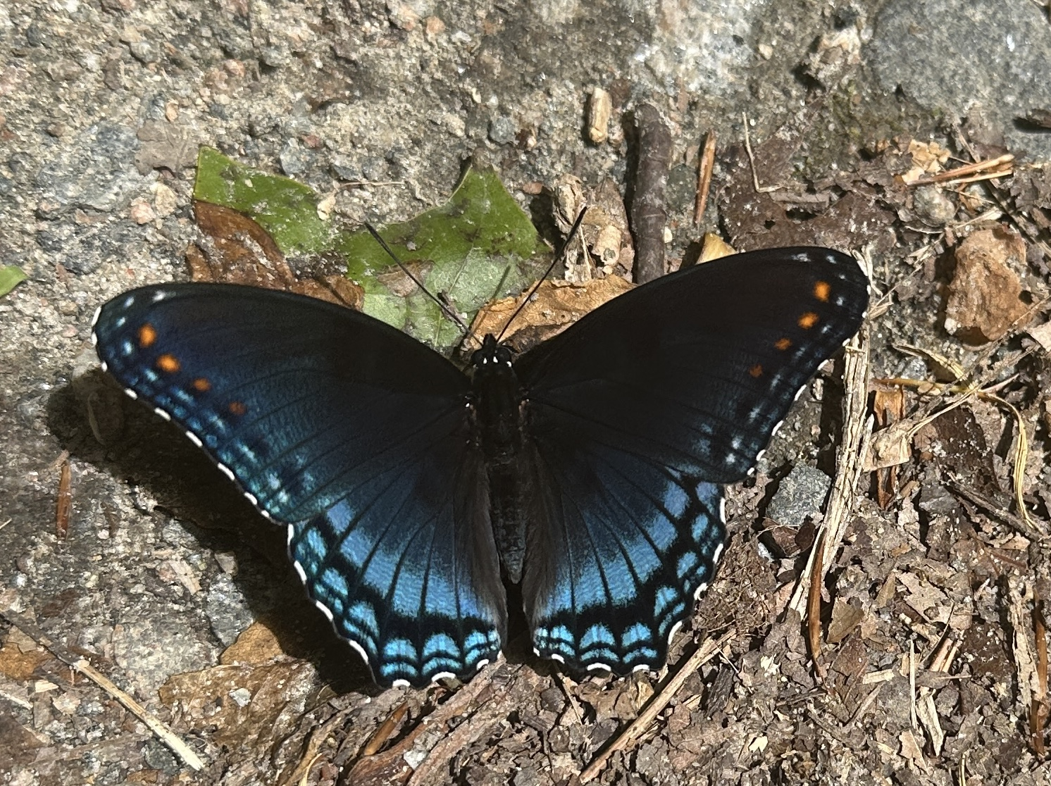
Break

Slide 58

Threat Management
Dean Johnson - Director
Kathy Bortle – Threat Intelligence and Vulnerability Manager
Scott Brinkley – Incident Response Manager
October 1, 2025

Slide 59
Incident Response
Scott Brinkley

Slide 60

Incident Response Projects
INCIDENT RESPONSE AUTOMATION INITIATIVE
Forensic Investigative Authorization Request (FIAR)
Digital FIAR Form is alive and well
  Forensic Investigation Authorization Request
Do not be afraid to reach out to fiar@vita.virginia.gov if you need the link or for attachments
  It is fed into a Microsoft List and you may see that notation at the bottom of the form
  That Microsoft List is still only accessible by those who have been cleared
Splunk Agency Information Security Dashboard

Slide 61
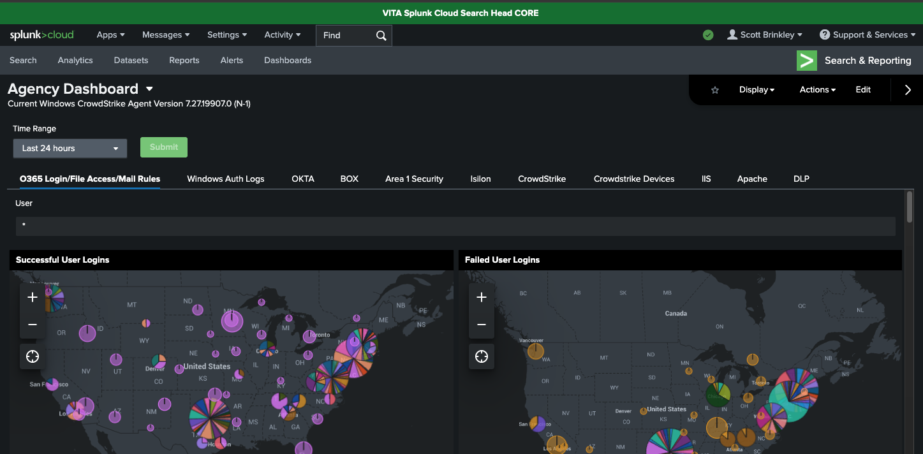
Information Security Dashboard

Slide 62

Information Security Dashboard
O365 Login/File Access/Mail Rules
Windows Auth Logs
OKTA
BOX.com
Area1 Security
Isilon
Crowdstrike
Crowdstrike Devices
IIS
Apache
DLP

Slide 63

Commonwealth of Virginia Tabletop Exercise
COV TTX
SAIC’s MSI-SIRT team has been working with CSRM IR and the SOC to provide the Commonwealth Annual Tabletop Exercise
Exercise Date: October 28th (10AM-4PM)
*This includes break times*
After-Action Date: October 29th (11AM-12PM)
RSVP cut off is Oct 17th
*msi-security-operations@saic.com*
More details will be provided after October 17th to those that RSVP

Slide 64
Threat Intelligence and Vulnerability Management
Kathy Bortle

Slide 65
Threat Intelligence and Vulnerability Projects
USER-REPORTED PHISHING
KnowBe4 spun down as Phishing Alert Button
A new phishing alert button is now live
NUCLEUS AUTOMATED TICKETING

Slide 66

Nucleus Security - Vulnerability Awareness
Nucleus Security
Weekly scan calls have been discontinued
Nucleus ticketing is being rolled out to agencies and is scheduled for completion by the end of October
All tickets generated by Nucleus are assigned according to the ESSP
To contact the Nucleus team, please submit a VCCC ticket for all questions and requests for assistance - This will allow the entire team visibility into the issue

Slide 67
Questions?

Slide 68
VITA COV Ramp Team
2025 Accomplishments and 2026 Plans
Debi Smith
COV Ramp Security Architect Manager
October 1st, 2025

Slide 69
COV Ramp Team – Who We Are
Debi Smith
Oversight
Adrienne Archer
Wilbert Jones
Andre King
Cloud Terms
Iris Frimpong
Shae Jenkins
Audit
Marlon Cole
Assessments
Sharon Richardson
Vishal Abbagani

Slide 70
COV Ramp Team – 2025 Accomplishments
Over 100 new security assessments completed and approved
Over 350 security exceptions completed
Over 100 new oversight requests received
Over 100 security audits completed
Over 50 new cloud terms and conditions negotiated

Slide 71
COV Ramp Team – 2025 Accomplishments (cont’d)
Updated Over 250 SEC 525 assessments to align with SEC 530
Implemented and rolled out the Power BI Dashboard for Transparency
Collaborated on new versions of Cloud Terms and Conditions
  Low Risk
  Medium Risk
  High Risk

Slide 72
COV Ramp Team – 2026 Priorities
Proactive / Communications / Documentation
Completion of Re-Reviews for SEC530
  Re-review of old SEC 525 assessments for updates to SEC 530
Roles and Responsibilities Matrix for Team
  Documentation of Team Roles and Responsibilities
Formalization of New Cloud Terms for Expedited Low Risk Solutions
  Training and Comms for the role out of the Low Risk Terms & Conditions

Slide 73
COV Ramp Team – 2026 Priorities (cont’d)
Proactive / Communications / Documentation
Rollout of Zen Desk
  Testing and Rollout to expedite all phases of the COV Ramp Team Tasks
Updated Training Videos
  Update Training Videos to allow for better understanding of the COV Ramp Process

Slide 74
Questions?

Slide 75
Security Products Team
Driving Innovation, Quality, and Engagement Across Our Product Portfolio
Uma Seshakrishnan

Slide 76
Reflecting on Success: Highlights from Last Year
Standardized product lifecycle
Established onboarding & continuous management processes for consistency.
Created product documentation
Functional, technical, and training materials for existing products.
Completed first product evaluation exercise
Gathered valuable insights to improve product quality.
Developed intake processor form
Standardized requests and problem statement submissions.
Conducted Acunetix user survey
Collected feedback directly from product users.

Slide 77

The Journey Forward: Our Roadmap for Success
Main Goals: Customer Engagement and Continuous Product Evaluation
Drive customer engagement by leveraging direct feedback channels to optimize user activation, retention, and lifetime value. Focus on building a user-centric experience that fuels advocacy and reduces churn.
Implement continuous product evaluation through iterative hypothesis testing, data-driven prioritization, and backlog refinement. Ensure rapid validation to align product-market fit and accelerate value delivery.

Slide 78
Customer Engagement
Training
&
Support
Launch a series of targeted workshops to provide interactive, hands-on training sessions for users.
Create comprehensive training videos to support smoother and faster onboarding experiences.
Clearly communicate where users can easily locate user guides and other essential resources for self-help.
Implement query logging system to track issues and questions efficiently

Slide 79
Continuous Product Evaluation
Regular user surveys to monitor product health
Define & track KPI metrics to identify gaps and measure performance
Conduct market analysis for identified gaps to ensure product-market fit

Slide 80
Other Important Information & Next Steps
Training Resources:
Find user guides and onboarding videos under CSRM Connections - ISO Resources.
Share Your Feedback:
Your input fuels continuous improvement, let us know what’s working and what’s not.
Get in Touch:
Reach out at Uma.Seshakrishnan@VITA.Virginia.gov for questions, feedback, or collaboration opportunities regarding our products.
Contact Us For:
Training support, product discovery needs, new feature requests, or pain points requiring solutions.

Slide 81
Questions
Richard White
Richard.White@vita.virginia.gov
Uma Seshakrishnan
Uma.Seshakrishnan@vita.virginia.gov
Notes:
This slide is used as a transition title slide for a new section

Slide 82
IS Education and Relationship Management
Kendra Burgess
Kendra.Burgess@vita.virginia.gov

Slide 83

Announcements
ISOAG October 2025
Notes:
Example of when to use this slide background for a call out section and text

Slide 84

SPLUNK UPDATE September 2025
WE WANT YOUR LOGS: VITA is working with agencies to ingest their application logs in to the VITA Splunk instance. We ask that all agencies start identifying what logs you would like to have ingested. We are always happy to schedule a call to review your options.
Notes:
Example of when to use this slide background for a call out section and text

Slide 85


Top 5 Vulnerabilities
For the month of October, the Top 5 Key Vulnerabilities are:
PuTTY < 0.71 Multiple Vulnerabilities
BeyondTrust Privilege Management for Windows < 25.2 Privilege Escalation (BT25-01)
Microsoft Teams < 1.6.0.18681 RCE
Citrix Workspace App for Windows Multiple Vulnerabilities (CTX691485)
Microsoft Azure Data Studio < 1.48.0 Elevation of Privilege Vulnerability (CVE-2024-26203) (192147)
*NOTE* Check CSRM Connections for more detailed information
vita.virginia.gov
Notes:
This slide background works best with text heavy sections, with no imagery OR when an Icon is used

Slide 86
Upcoming Events
vita.virginia.gov
Notes:
This slide is used as a transition title slide for a new section

Slide 87

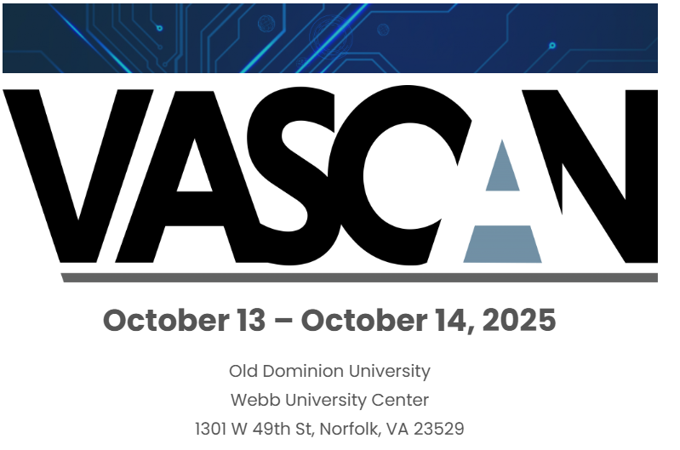

VASCAN
Registration is now open!
Notes:
Example of when to use this slide background for a call out section and text

Slide 88

Governance Office Hours Announcement
Governance Office Hours launch recently – a dedicated space for Agency ISOs and teams to bring their questions, concerns, or ideas directly to the Governance Team.
What to Expect:
Open discussion place
Governance Updates
Q&A and support for your needs
Next Session:
October 15th, 2025 | Microsoft Teams
[Click here to join the meeting]
Let’s work together to strengthen governance across the Commonwealth!
Notes:
Example of when to use this slide background for a call out section and text

Slide 89

Service Tower SOC Report Review Sessions
      To register for this meeting, please click on the link below: https://covaconf.webex.com/weblink/register/r4a05e20b703d317948bbc133e6645dd8
The upcoming SOC review session is December 11, 2025, and will be held remotely.
Please register at the link below
Notes:
Example of when to use this slide background for a call out section and text

Slide 90

IS Orientation
The next IS Orientation is being held on December 11, 2025
  December 11, from 9am to 4pm, registration closes Dec 1th.
  It will be held in-person at the Boulders location:
  7325 Beaufont Springs Drive, Richmond, VA 23225
  Visit Commonwealth IS Orientation to register!
Notes:
This slide works best with photos and graphs/charts. Image and text can be reversed

Slide 91
MEETING ADJOURNED
Notes:
Title slide - Any text that looks black is HEX code 414042. If you have an idea for an image, let me know and I can provide you with one.

